Slide 1
EASYFUNC SYSTEM
Le Duy Hanh 51000896

Slide 2
Overview
System overview
Parse API
Indexing
Code generation
View

Slide 3
Overview
System overview
Parse API
Indexing
Code generation
View

Slide 4
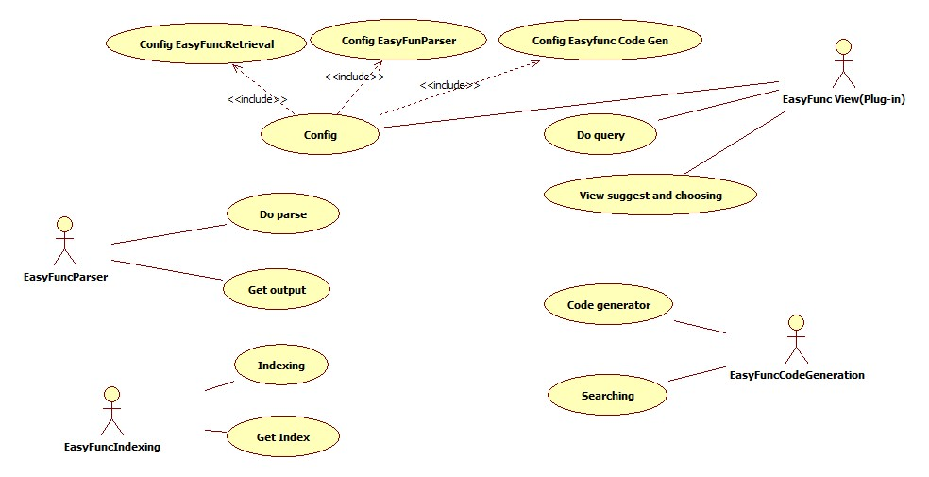
System overview

Slide 5
Lucene in a search system
Users
Index document
Analyze document
Search UI
Index
Build document
Build query
Render results
Acquire content
Raw Content
Run query

Slide 6
Overview
System overview
Parse API
Indexing
Code generation
View

Slide 7
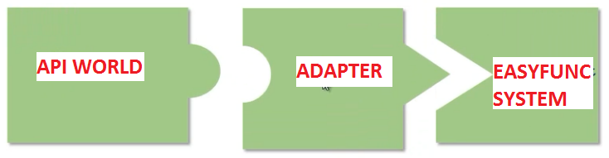
Parse API

Slide 8
Overview
System overview
Parse API
Indexing
Code generation
View

Slide 9
Indexing
Using lucene
Complete status: 90% done
Problem
Some more field not optimize
English analyzer in Lucene work so bad ☹ => must using Wordnet Analyzer

Slide 10
Overview
System overview
Parse API
Indexing
Code generation
View

Slide 11
Searching
Complete status: Just started

Slide 12
Seaching problem
BIG PROBLEM
Others problem
Ranking result
Processing nature language
Autofix grammar query
Hightligh result

Slide 13
Code generation
Complete status: Didn’t start

Slide 14
Overview
System overview
Parse API
Indexing
Code generation
View

Slide 15
Plug-in
Comple status: 60% done

